Slide 1
Hydraulic jump simulation in COMSOL
Haoyu Lu
2023.03.07

Slide 2
Outline
Problem description
Simulation settings
How to distinguish the proper model
Initial and boundary conditions
Criterions of choosing contours
Results
Evolution cases – 3d and 2d_section spf and density diagrams
Different initial velocity
Different slopes of the plane

Slide 3
Problem description
The water flow is running down and when hitting the plane.
It ‘jumps’ to a height.
Try to discover inner reasons that occur this phenomenon
Entrance
Exit
Hydraulic jump

Slide 4
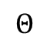
About the model : geometry and basic settings
No direct contact with the flow
Entrance
Apply slip-free condition
Exit
…
$$Θ$$
Change slopes of the plane
Notes:
No slip-free

Slide 5
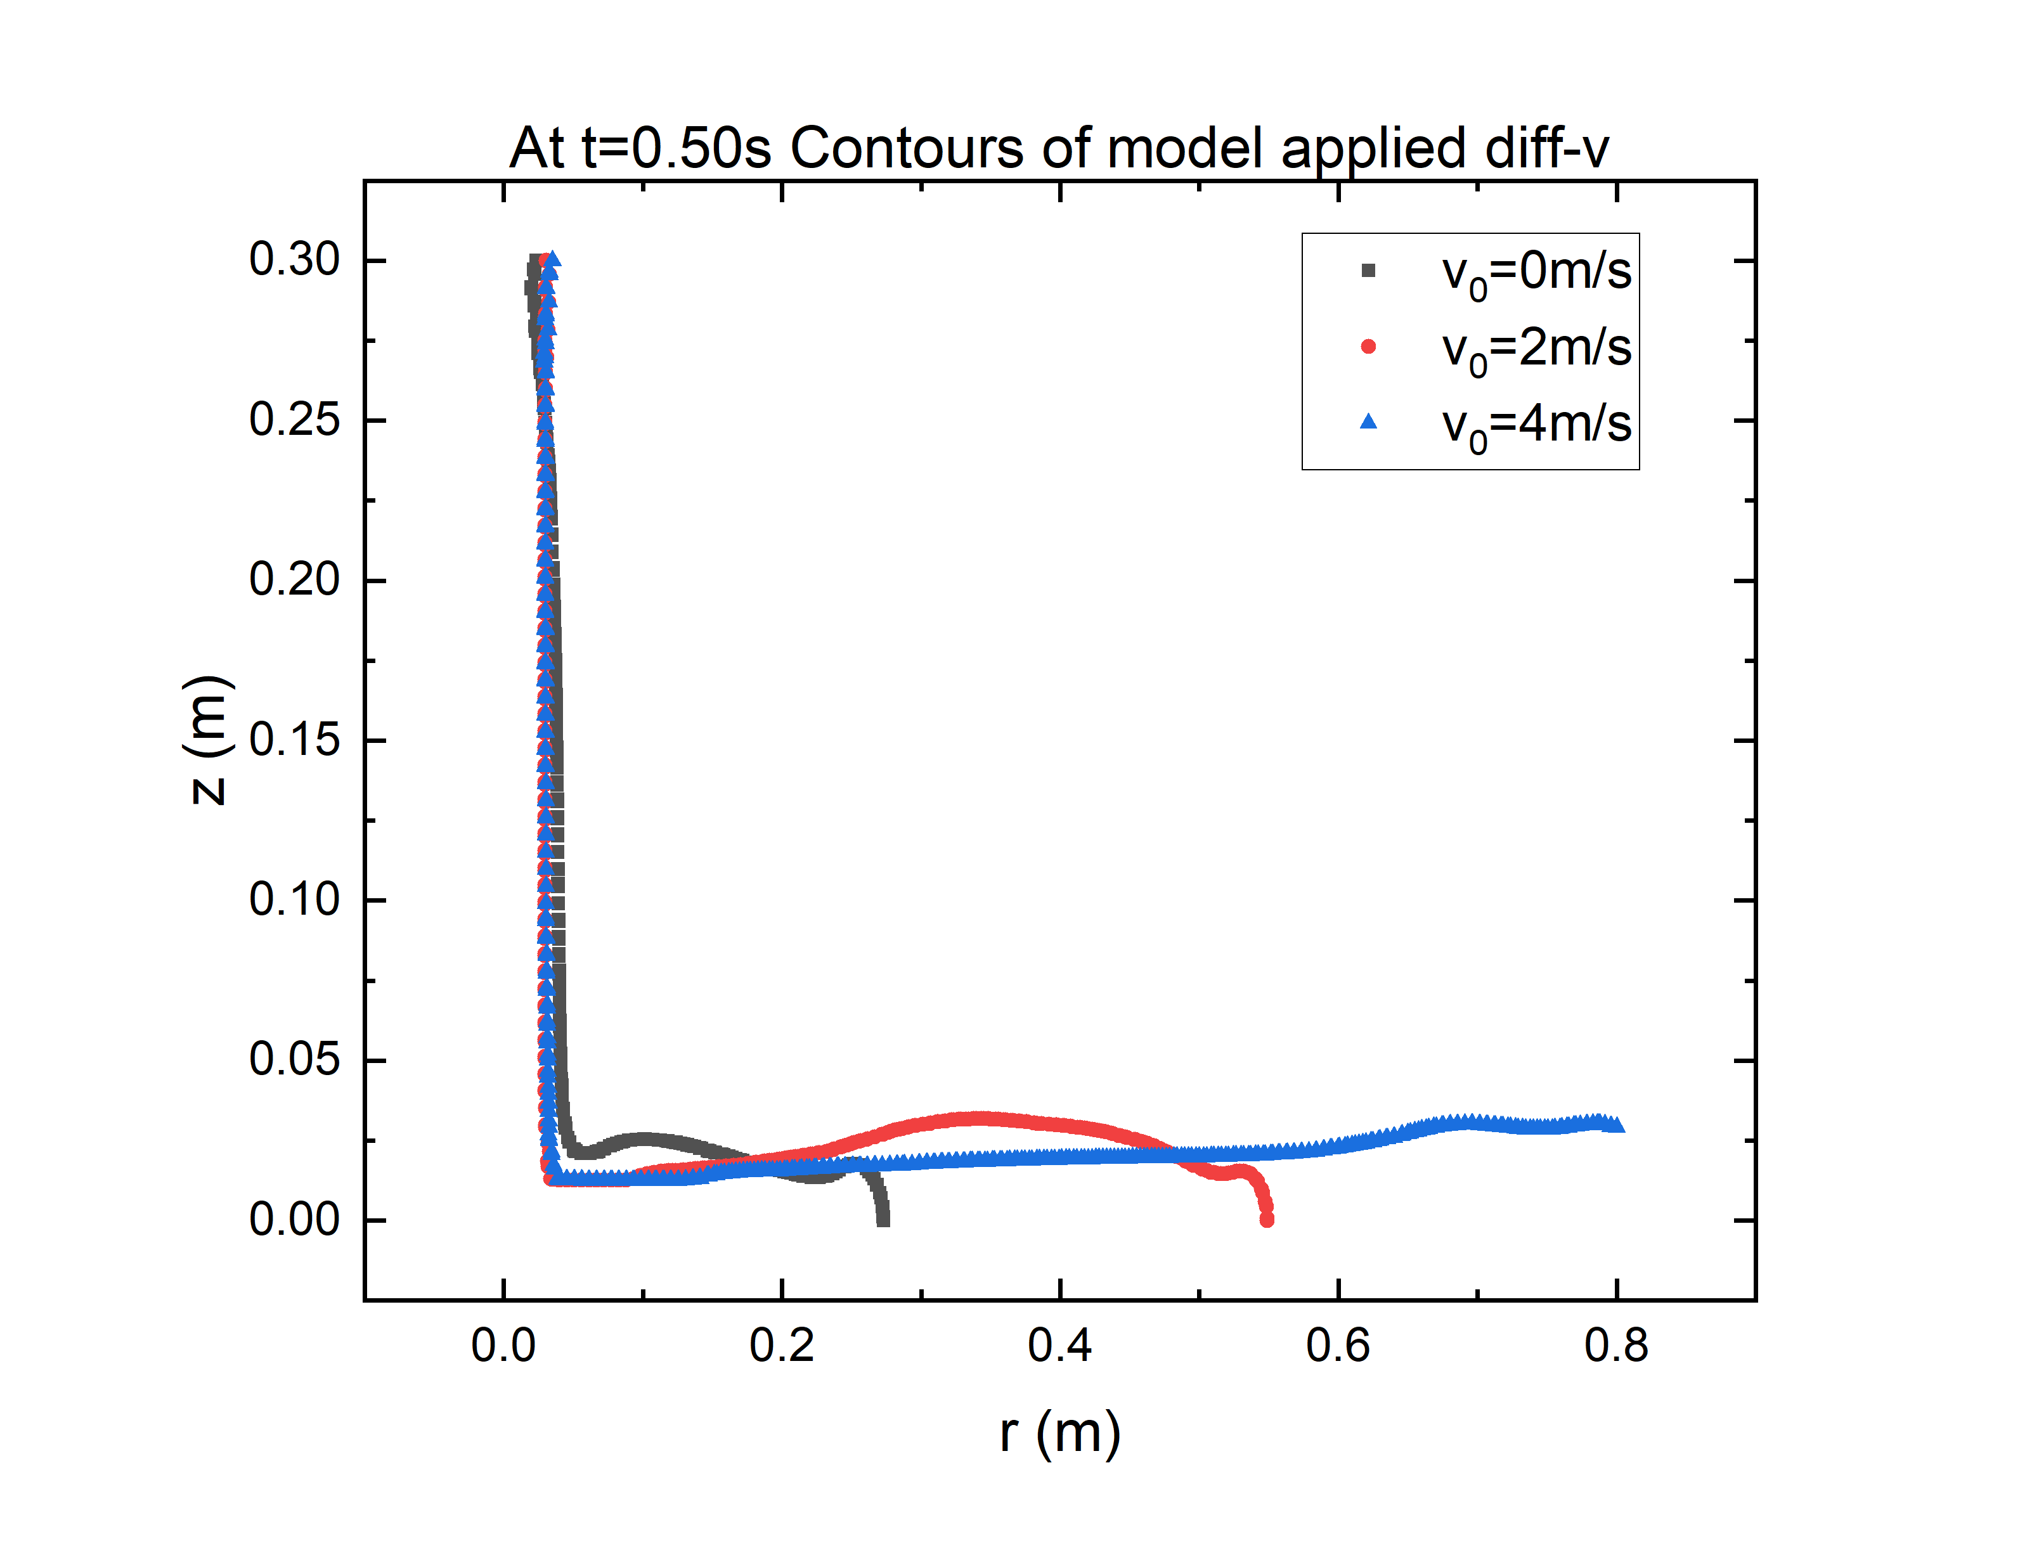
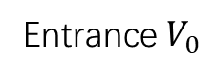
Initial condition - velocity
Entrance $V_{0}$
Exit
To find ‘full-developed’ scene, I choose $v_{0}=4m/s$ as the initial velocity

Slide 6
Criterions of choosing contours
A problem is : when considering slopes that has different angles or different initial velocities,
how to choose proper contours to present a result as ‘close’ as to the reality?

Slide 7
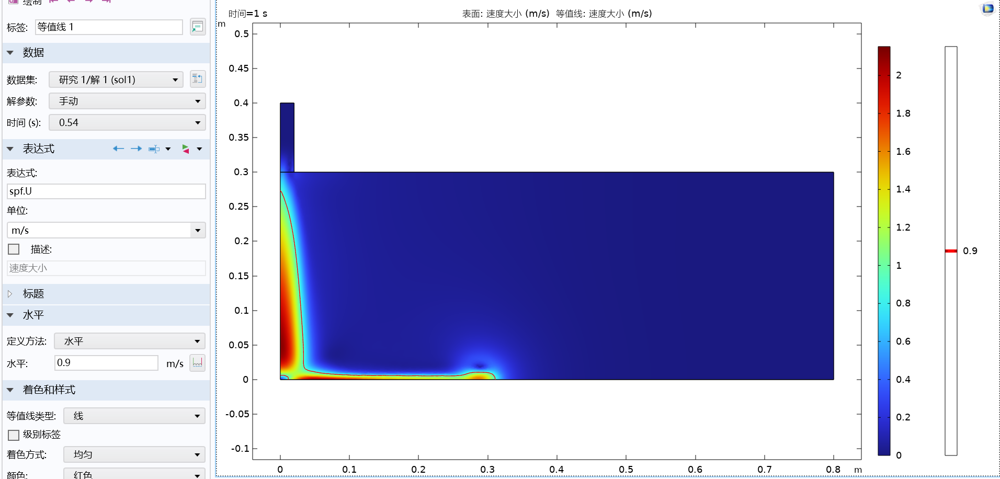
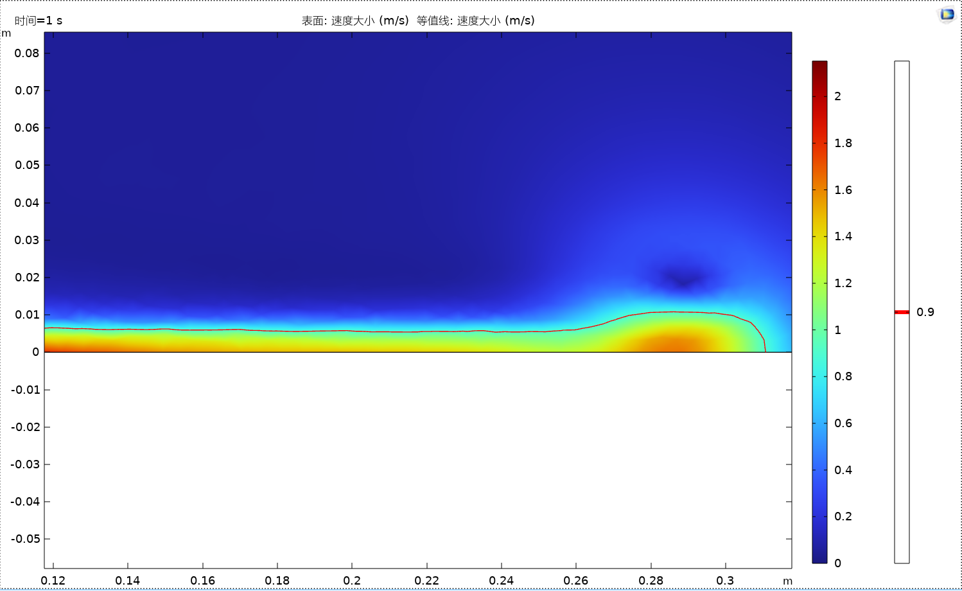
Criterions of choosing contours
Not correct actually

Slide 8
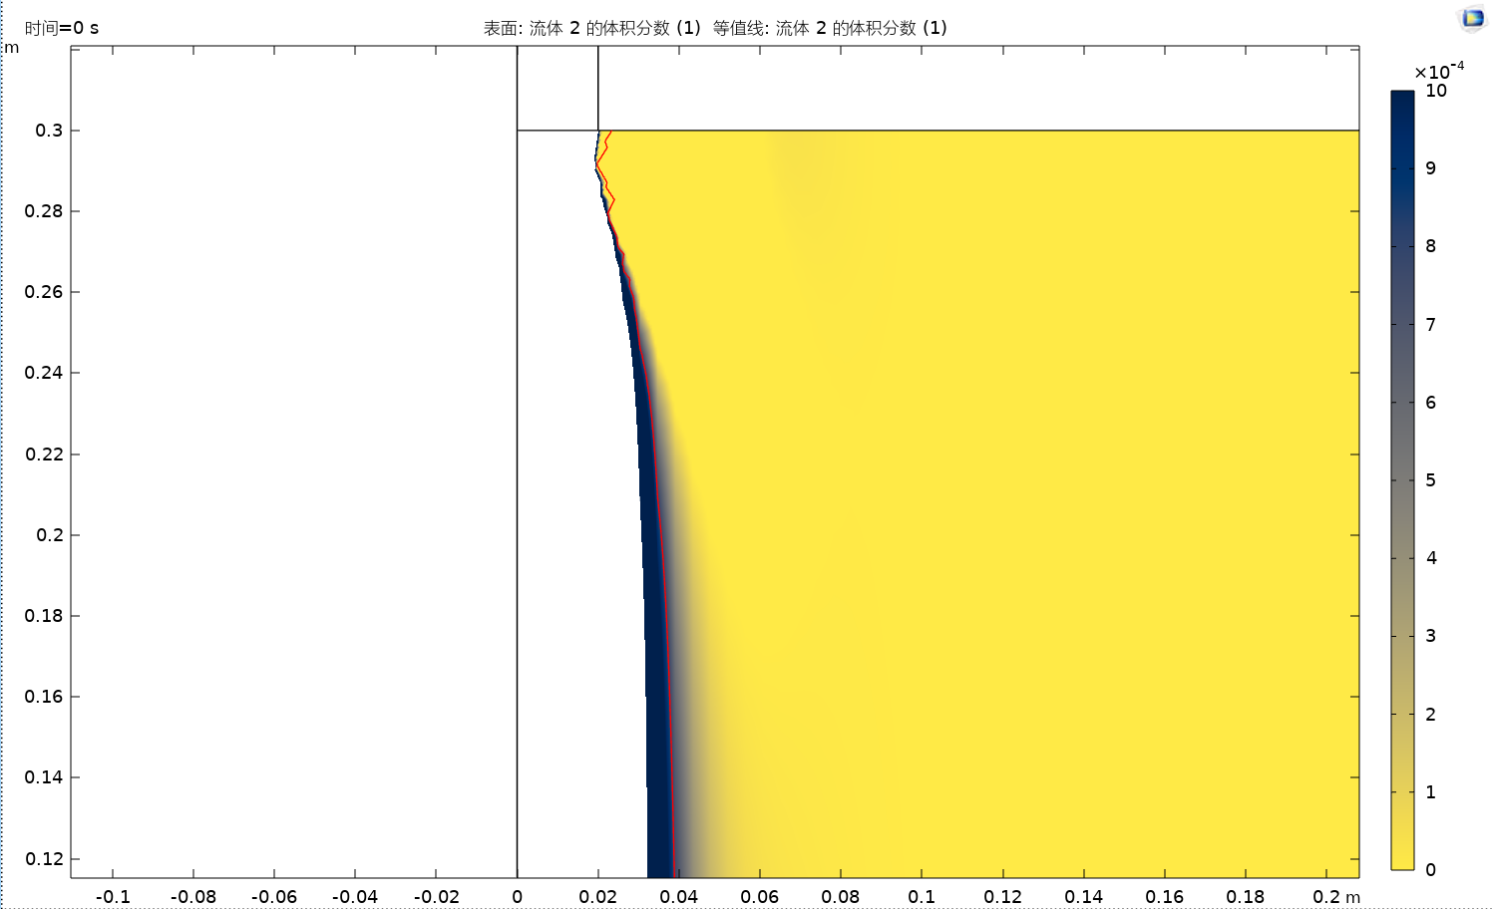
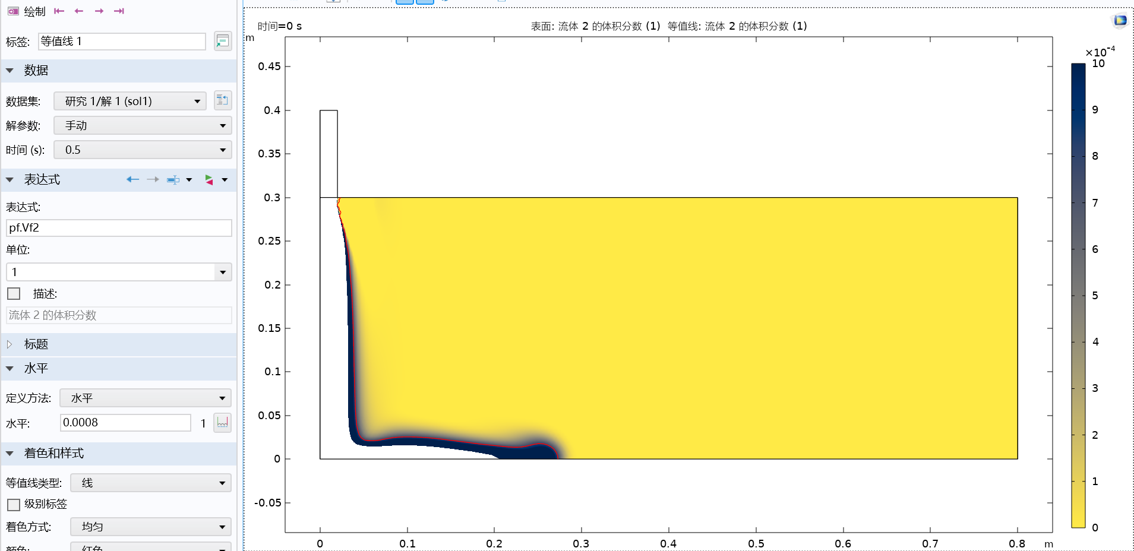
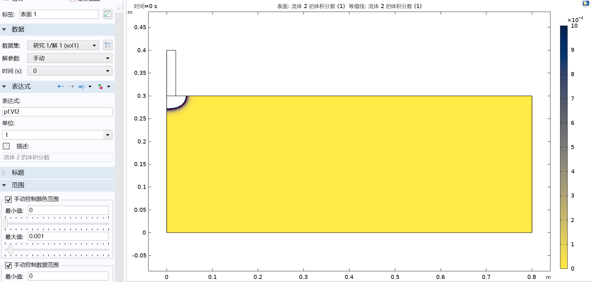
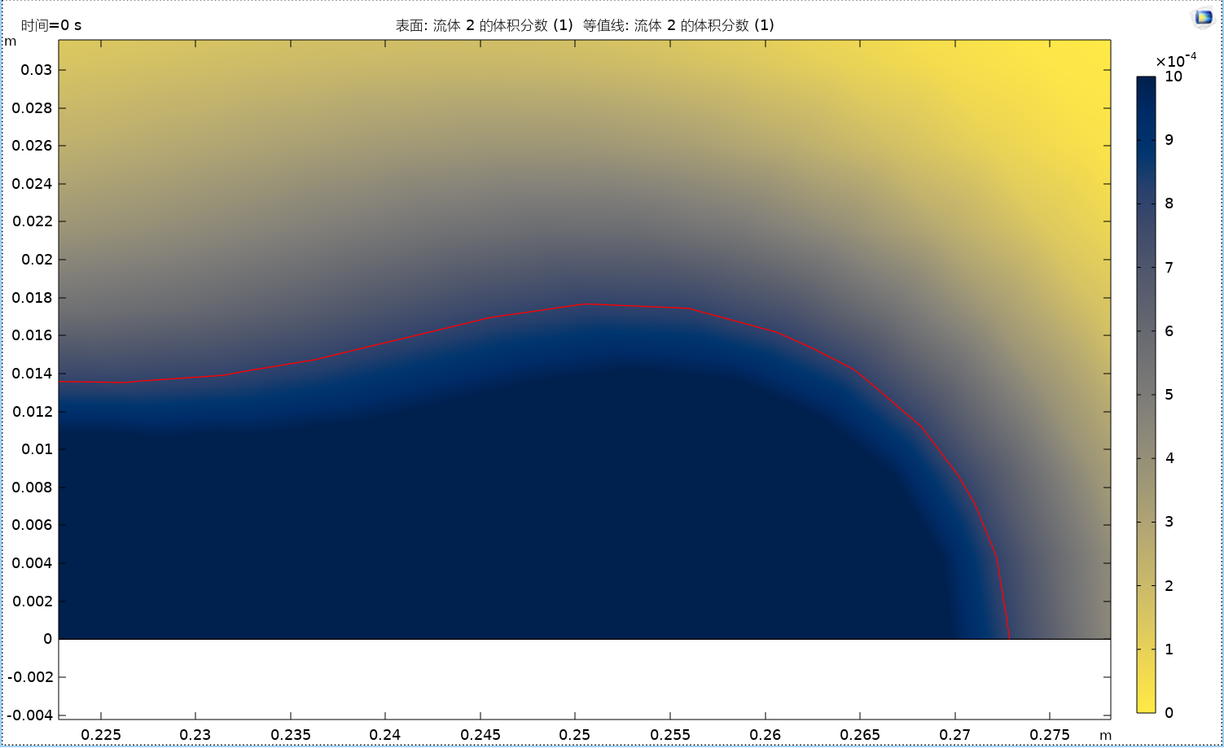
Criterions of choosing contours
Is this criterion enough? Not quite right.

Slide 9
Criterions of choosing contours
First frame and the frame that we use Corroborate each other

Slide 10
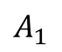
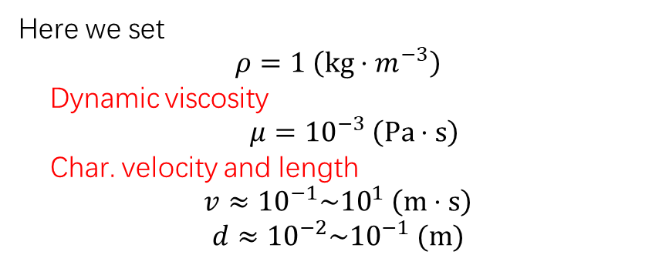
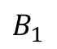

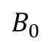
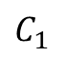
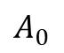
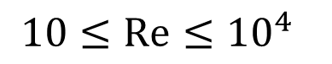
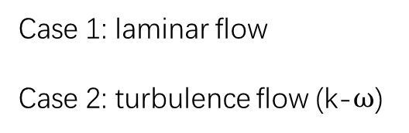
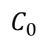
Use which model to simulate? – Re-number
Consider the Re-number
$$Re=\frac{ρvd}{μ}$$
Entrance
Exit
$$B_{0}$$
Here we set
$$ρ=1 \left(kg⋅m^{−3}\right)$$
Dynamic viscosity
$μ={10}^{−3} \left(Pa⋅s\right)$
Char. velocity and length
$$v≈{10}^{−1}\sim {10}^{1} \left(m⋅s\right)$$
$$d≈{10}^{−2}\sim {10}^{−1} (m)$$
$$C_{0}$$
$$A_{0}$$
$$A_{1}$$
$$C_{1}$$
$$B_{1}$$
$$10≤Re≤{10}^{4}$$
Case 1: laminar flow
Case 2: turbulence flow (k-$ω$)

Slide 11
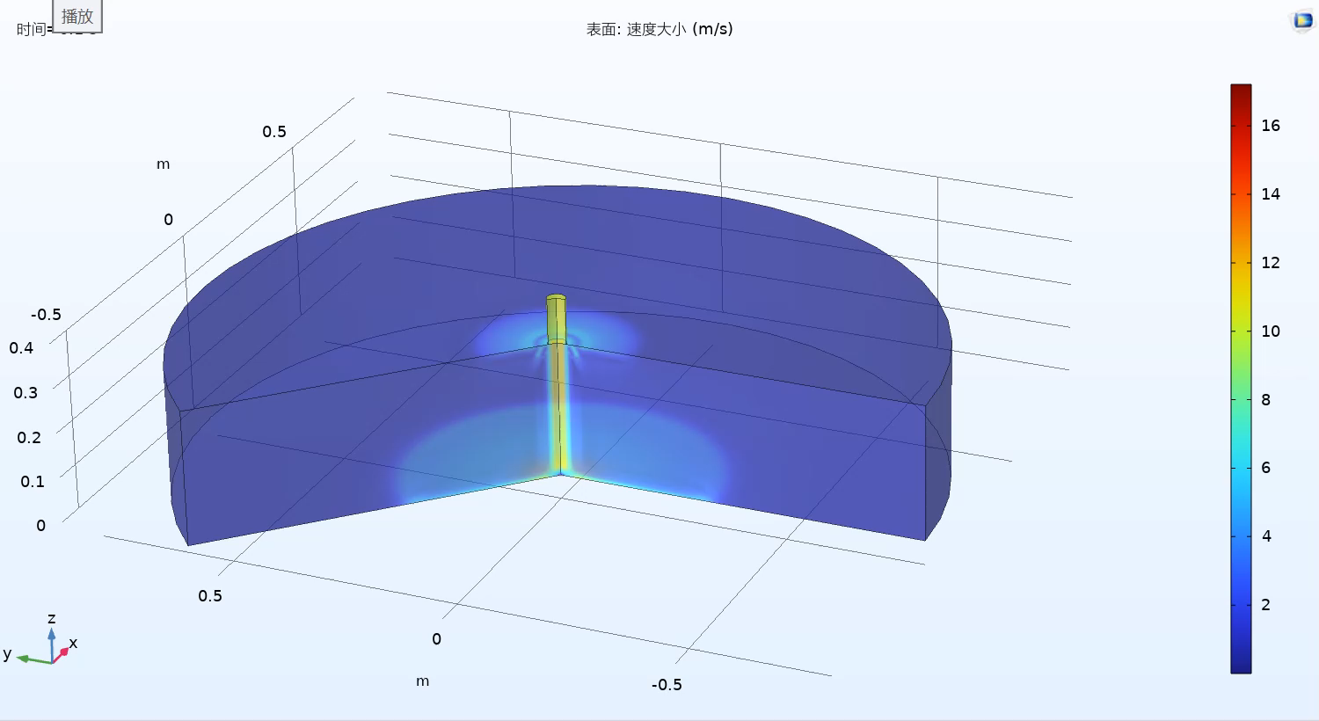
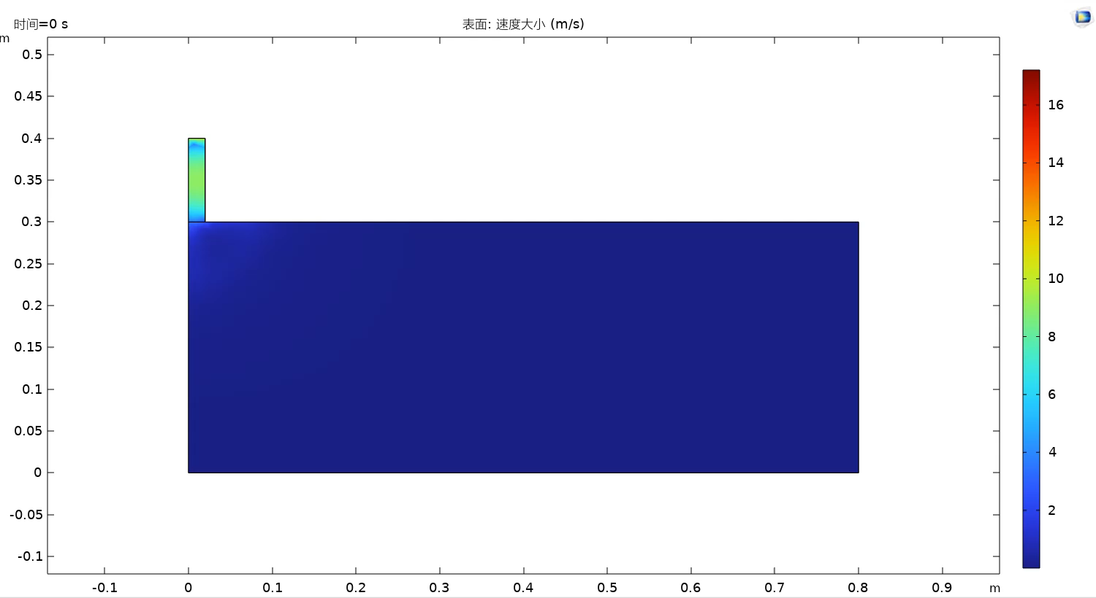
Use which model to simulate? – Re-number
Case 1: laminar flow

Slide 12
Use which model to simulate? – Re-number
Case 1: laminar flow

Slide 13

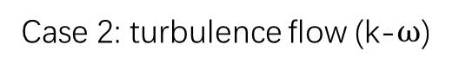
Use which model to simulate? – Re-number
Case 2: turbulence flow (k-$ω$)

Slide 14
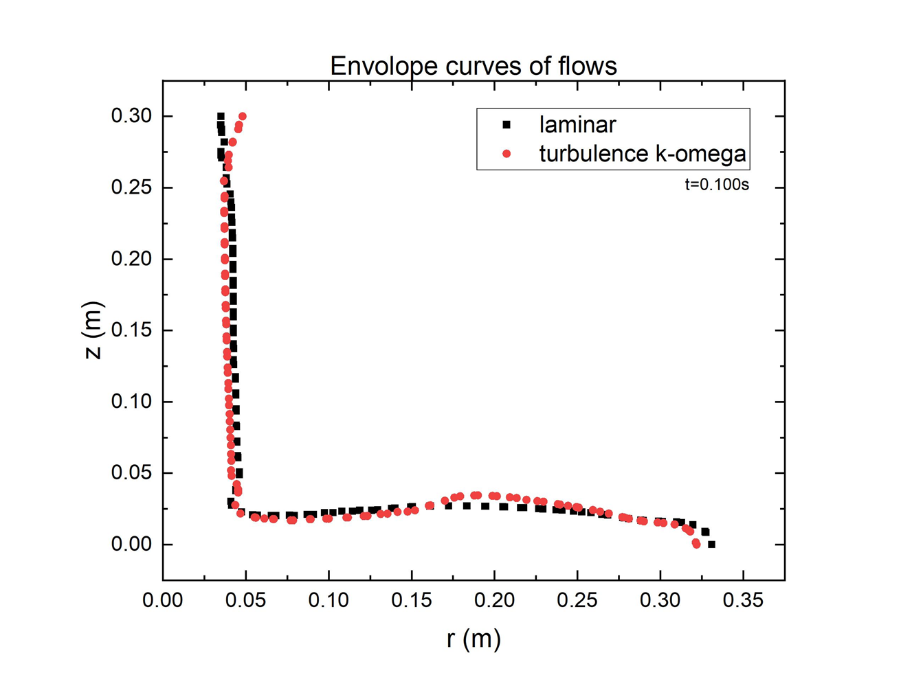
Use which model to simulate? – Re-number
Case 1: laminar flow
Case 2: turbulence flow (k-$ω$)

Slide 15
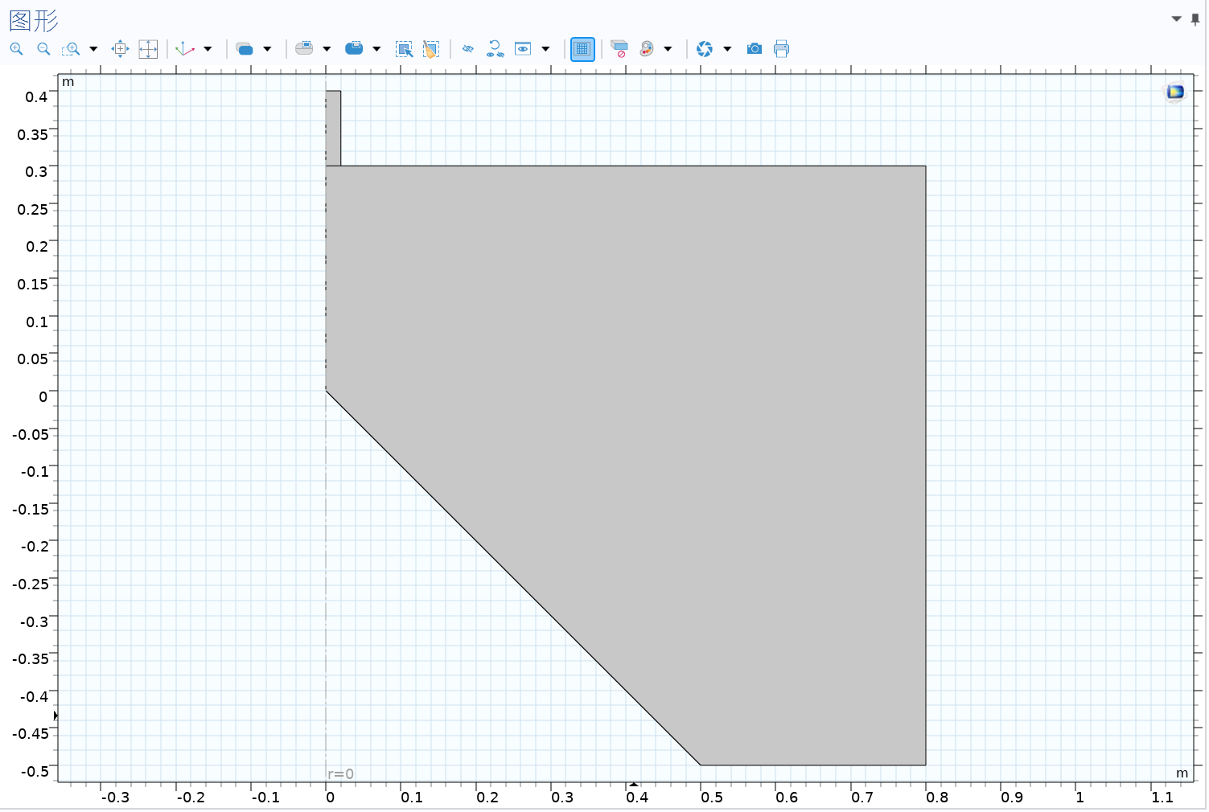
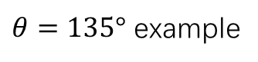
Results – Different slopes - Model
$θ=135°$ example

Slide 16
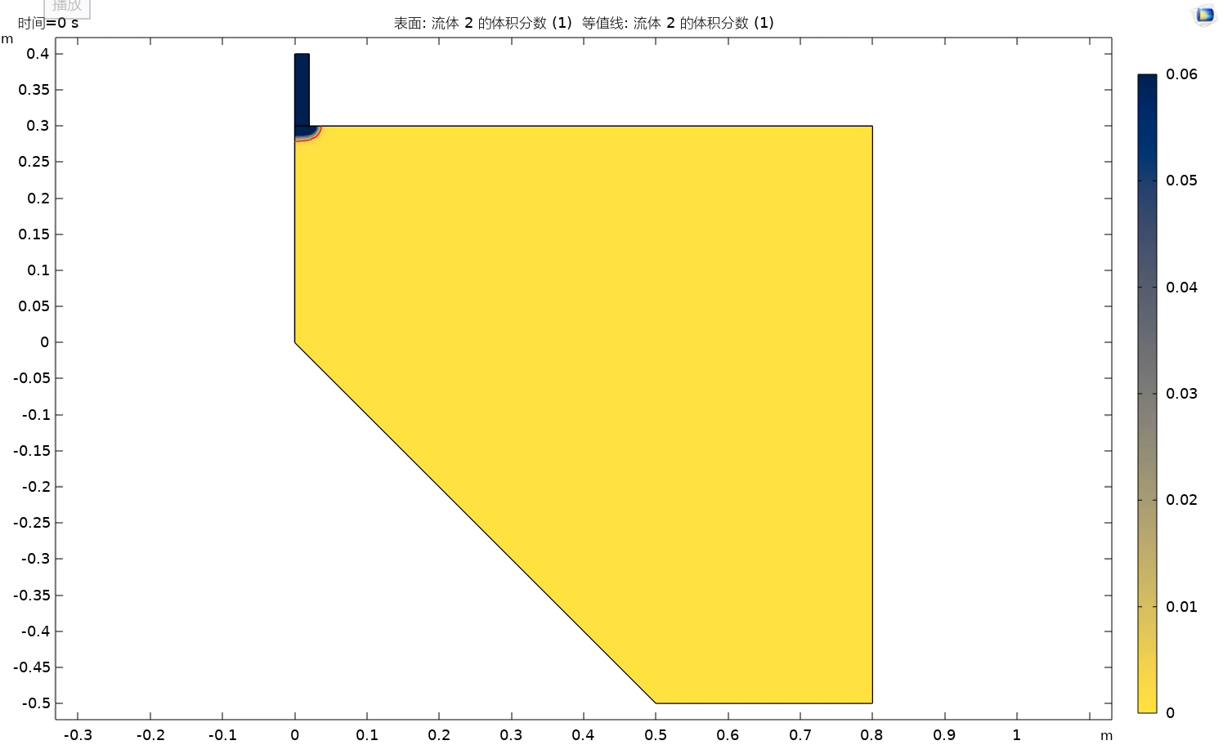
Results – different slopes
135 sample

Slide 17
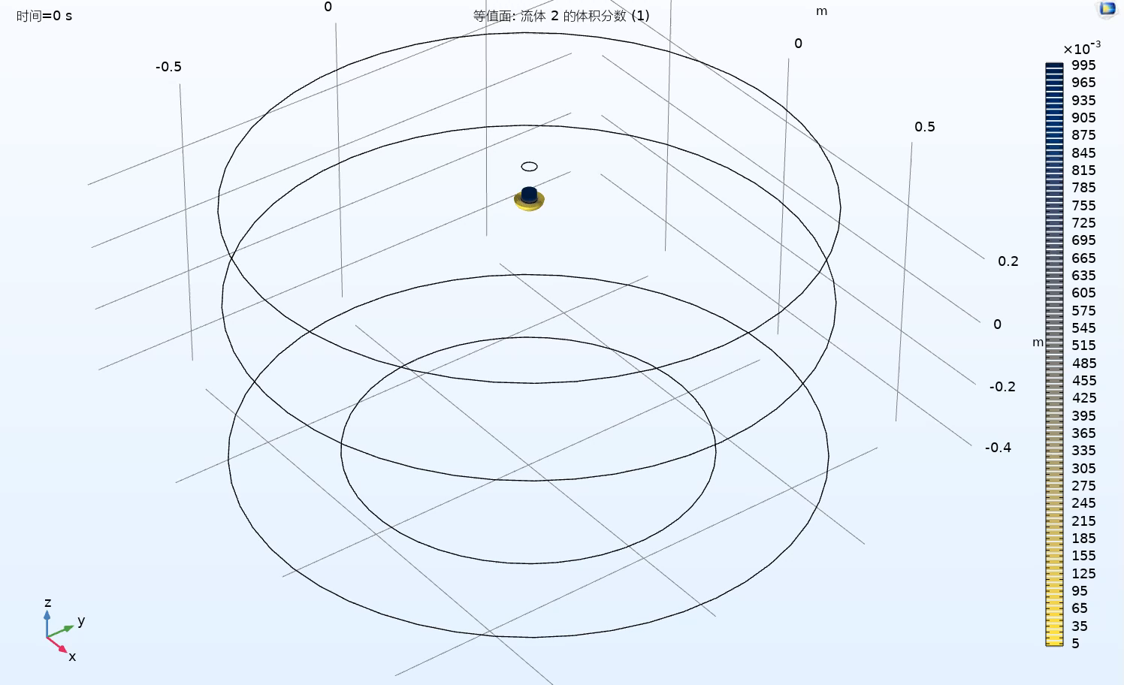
Results – different slopes
135 sample
Notes:
扰动量* – 借鉴边界条件 – 沙流问题

Slide 18
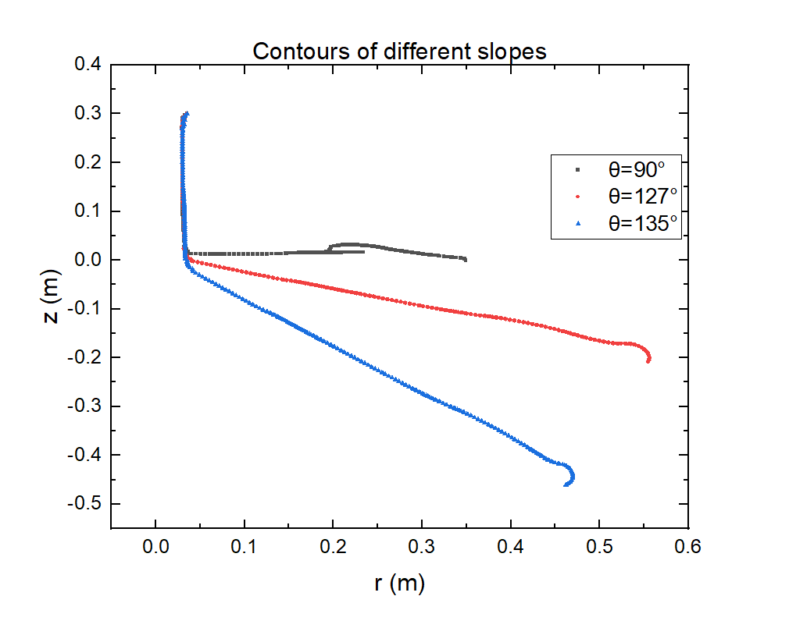
Results - Comparison

